Slide 1
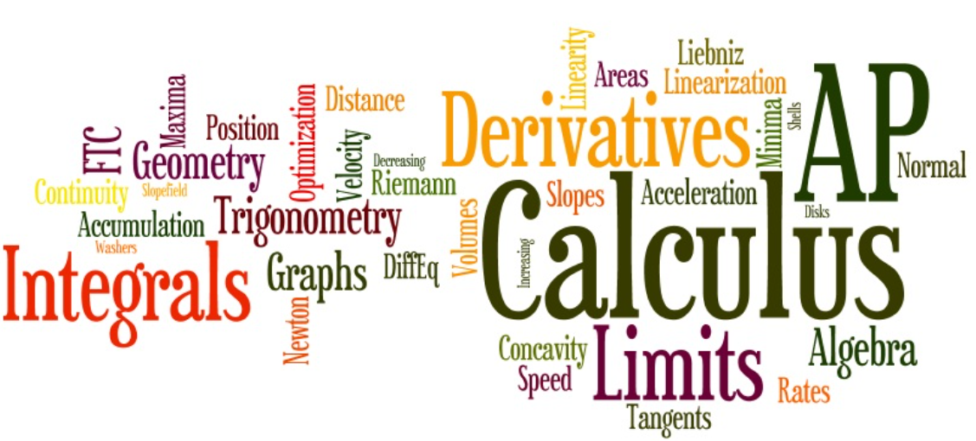
Create an UT EID
Mrs. Bithi

Slide 2
Click!
Notes:
https://quest.cns.utexas.edu/

Slide 3
Wait, Mrs. Bithi! I already have a UT EID! Then go to slide 16 to see how to enroll in my class.

Slide 4
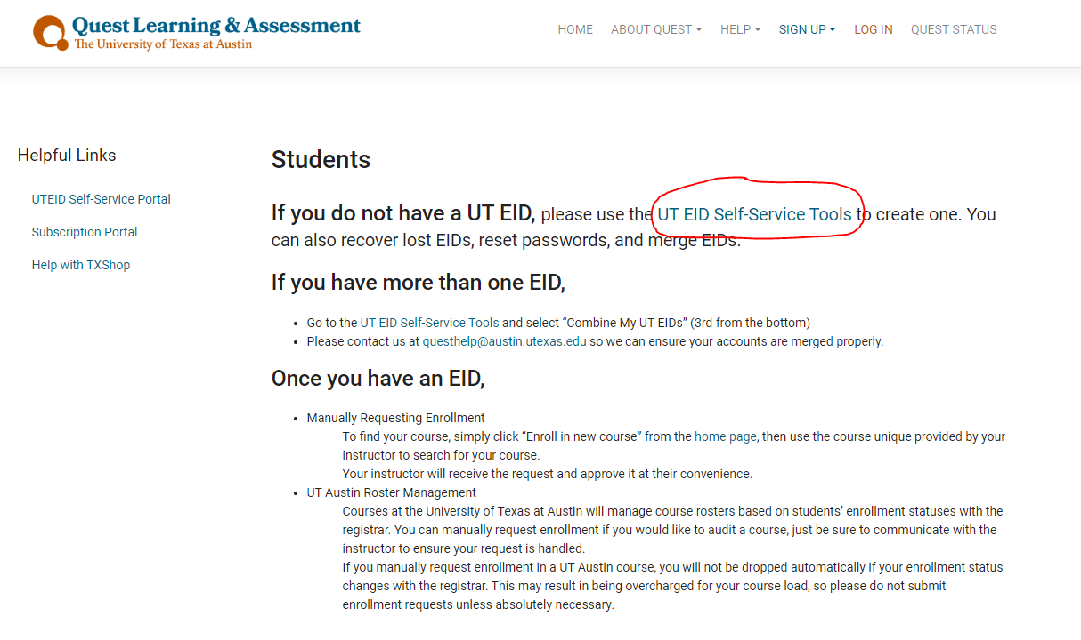

Slide 5
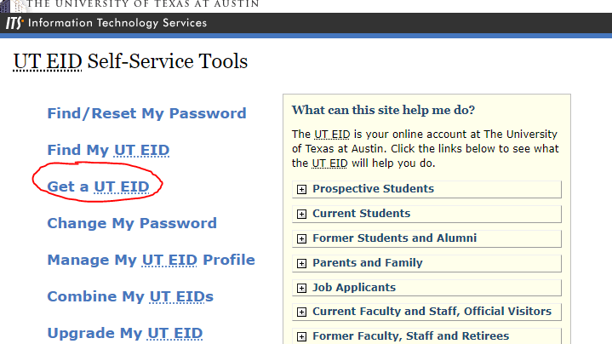

Slide 6
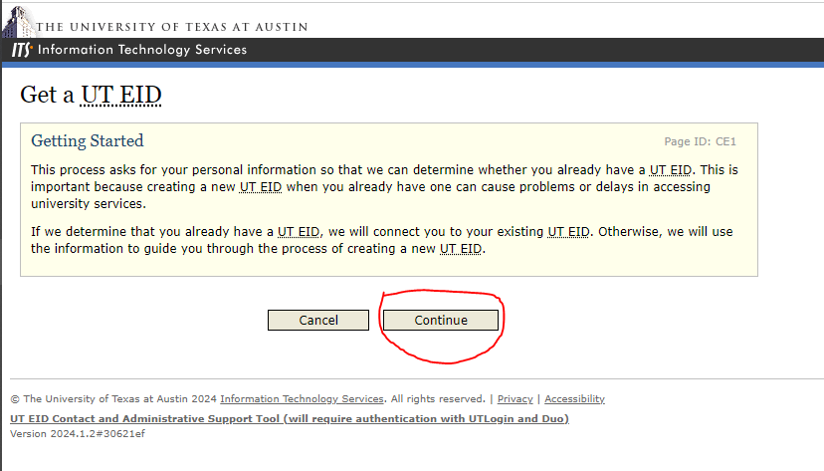

Slide 7
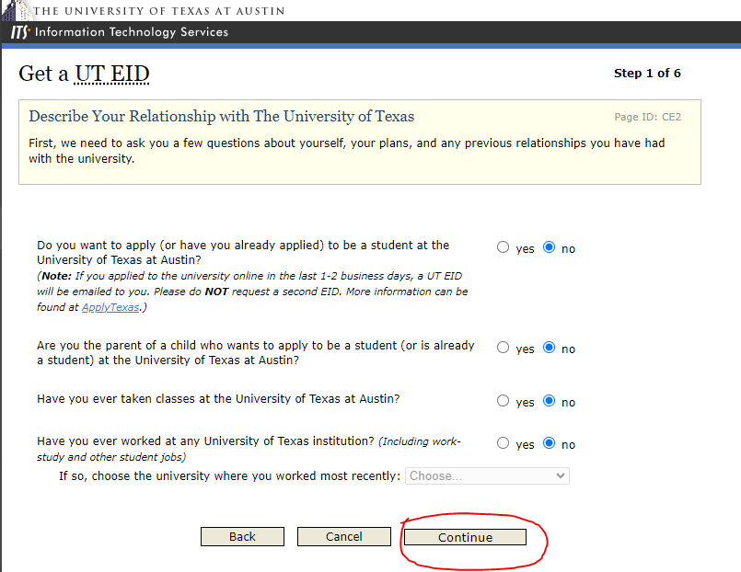

Slide 8
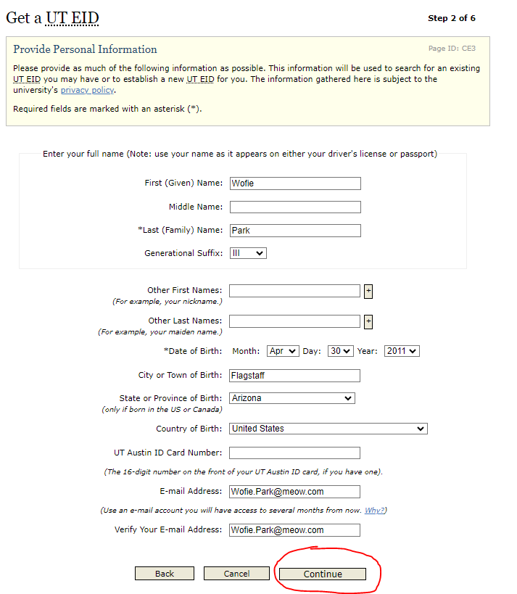

Slide 9
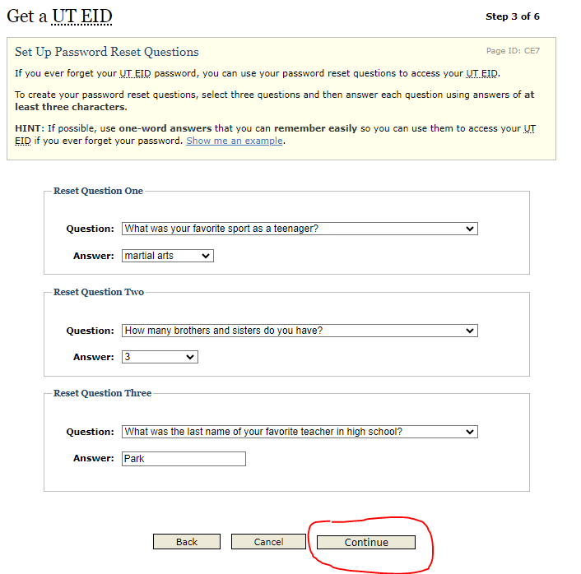

Slide 10
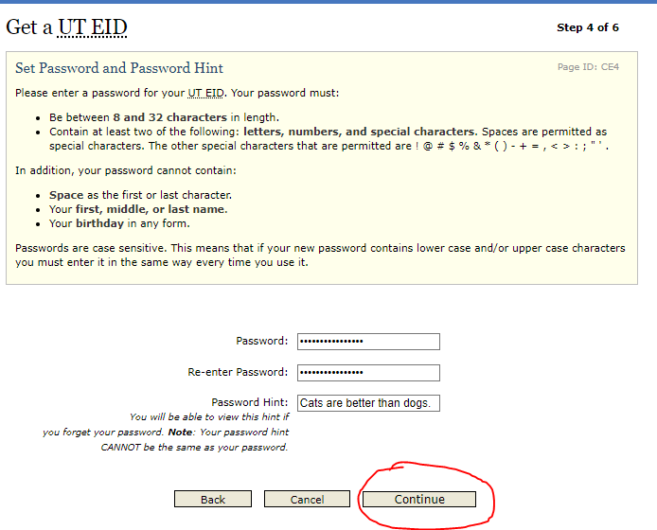

Slide 11
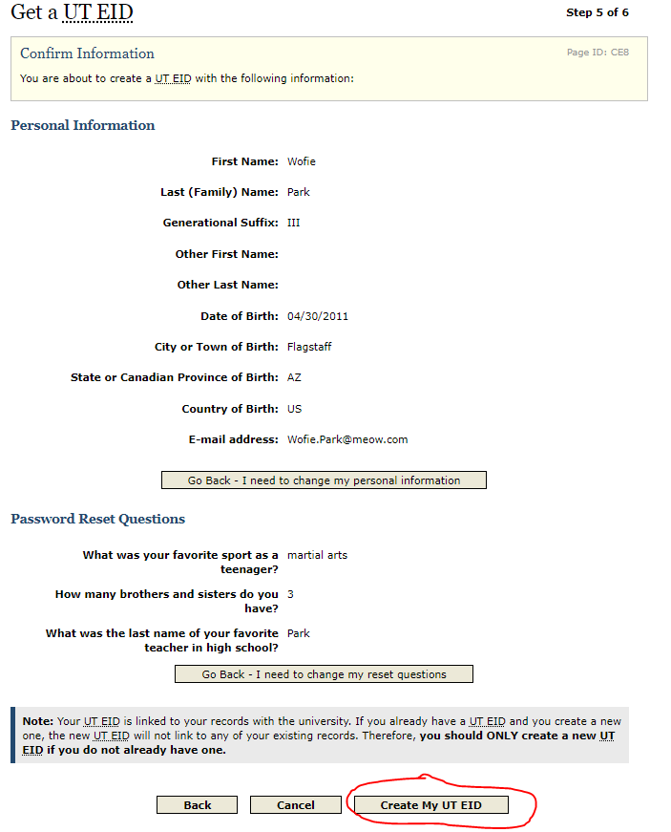

Slide 13
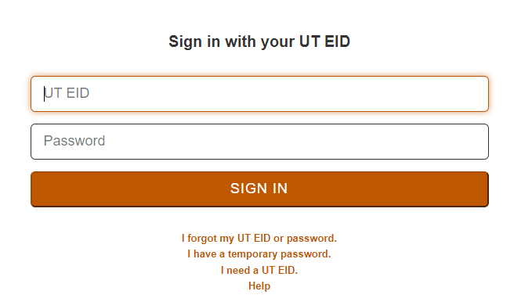

Slide 15
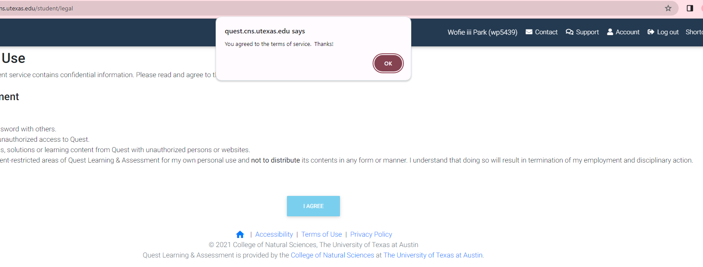

Slide 16
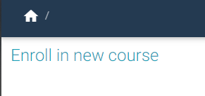
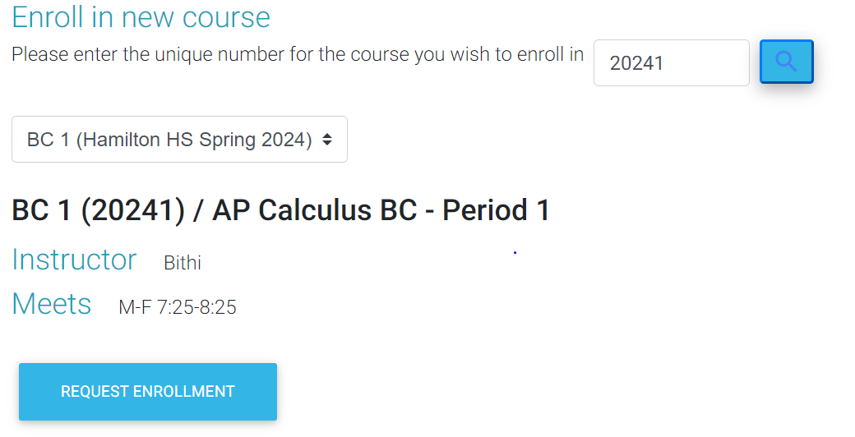
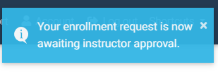
1
Your unique number for AP Calculus BC Class is
Example:
for AP Calculus BC – Period 1 is
20241
2
Click the arrows to find the course!
BC1(20241) (Hamilton HS Spring 2024)
3
4

Slide 17
What Now?
Wait until Mrs. Bithi approve your requests. Make sure you request it before the last day of school. Otherwise, she will approve whenever she feels like it.
Questions?
bithi.rabia@cusd80.com
D126

